Slide 1
EMOTIONAL FACIAL RECOGNITION SYSTEM
ReflectAI

Slide 2

RESEARCH TECHNOLOGIES FUNCTIONALITY DESIGN TESTING SMART MIRROR REFLECTION
INTRODUCTION

Slide 3

INTRODUCTION
Creating a smart mirror that recognizes a users emotions.
In recent years, there has been a rapid advancement in the field of artificial intelligence (AI) and its various applications. This has led to an increased interest in exploring the potential of AI in various industries, including healthcare, finance, and transportation.

Slide 4


RESEARCH
Applications being used :
Computer Vision - Computer vision is a field of artificial intelligence (AI) that enables computers and systems to derive meaningful information from digital images, videos and other visual inputs
Deep Learning - Deep learning is a method in artificial intelligence (AI) that teaches computers to process data in a way that is inspired by the human brain.
The Internet of Things (IoT) describes the network of physical objects—“things”—that are embedded with sensors, software, and other technologies for the purpose of connecting and exchanging data with other devices and systems over the internet.
Raspberry Pi & Arduino - Arduino is an electronic board with a simple microcontroller, whereas Raspberry Pi is a full-fledged computer.

Slide 5

TOOLS & TECHNOLOGIES
Various tools and technologies that
I’ve used throughout my thesis:
Azure Cognitive Services
OpenCV
Python
CSV
Excel
Pickle
CV2
DateTime
DLib
OpenFace
Facial Feature Detection Scripts.
Visual Studio Code, this is both an IDE and a text editor.
GitHub / Git
Facial emotion recognition system
NumPy library for numerical operations
Pandas library for data manipulation
Matplotlib library for data visualization
Artificial intelligence techniques

Slide 6

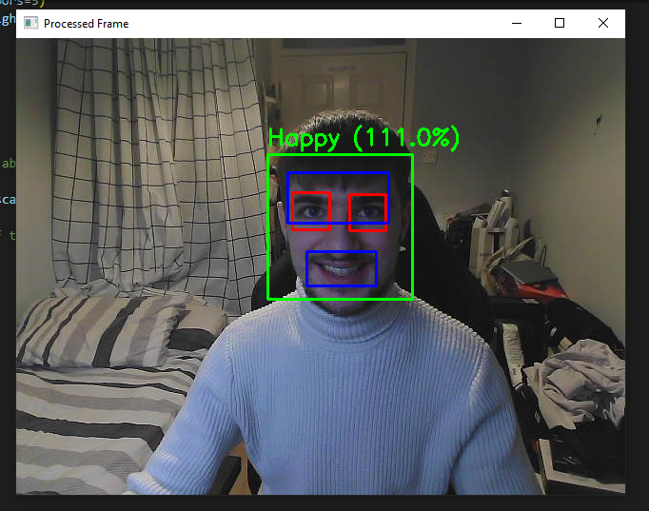
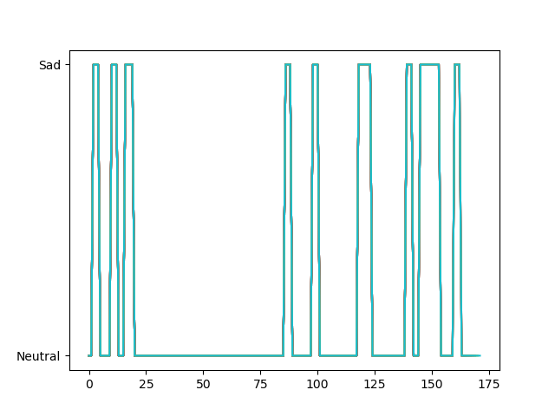
FUNCTIONALITY
Main functions that the system displays:
The code uses OpenCV to access your webcam and then Haar Classifiers to detect your facial features.
Custom Parameters set to detect emotions.
Shows a Live Graph of the data its receiving based on the emotions you are displaying.
Saves this data into 3 file types, CV2, Excel and PKL.
Physical Mirror with touch screen technology through the use of an Infrared Frame.

Slide 7

IMPLENTATION
Python
OpenCV
Azure Cognitive Services
Raspberry Pi
LED screen
2 Way Glass
Monitor

Slide 8
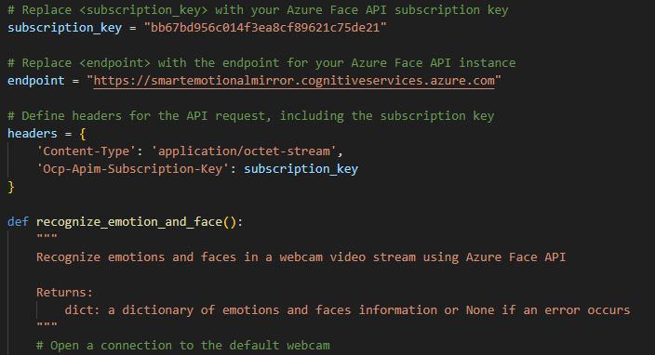
DESIGN
How It was designed:
View:
Clean and Simplistic.
Clear view for ease of Understanding.
Clear indications of facial features.
Code:
Correct indentations.
Commented each part.
Organized folder structure.

Slide 9
TESTING
Testing Techniques done:
Testing done throughout the code.
Utilizing the terminal.
Fail safes installed.
Error messages caught and displayed.
Unit Testing.
User Testing.

Slide 10

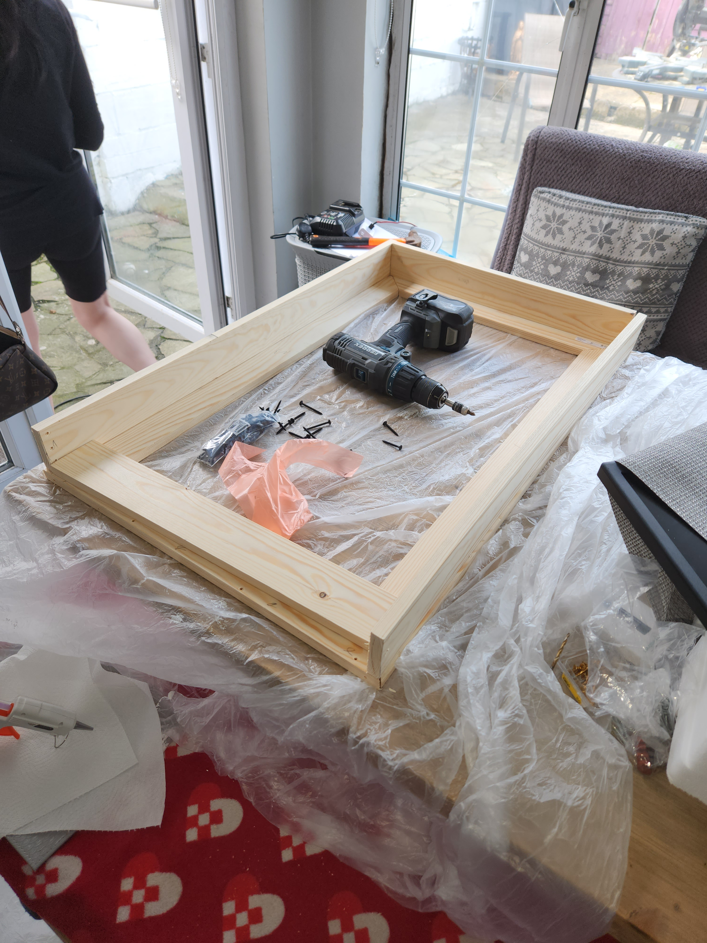
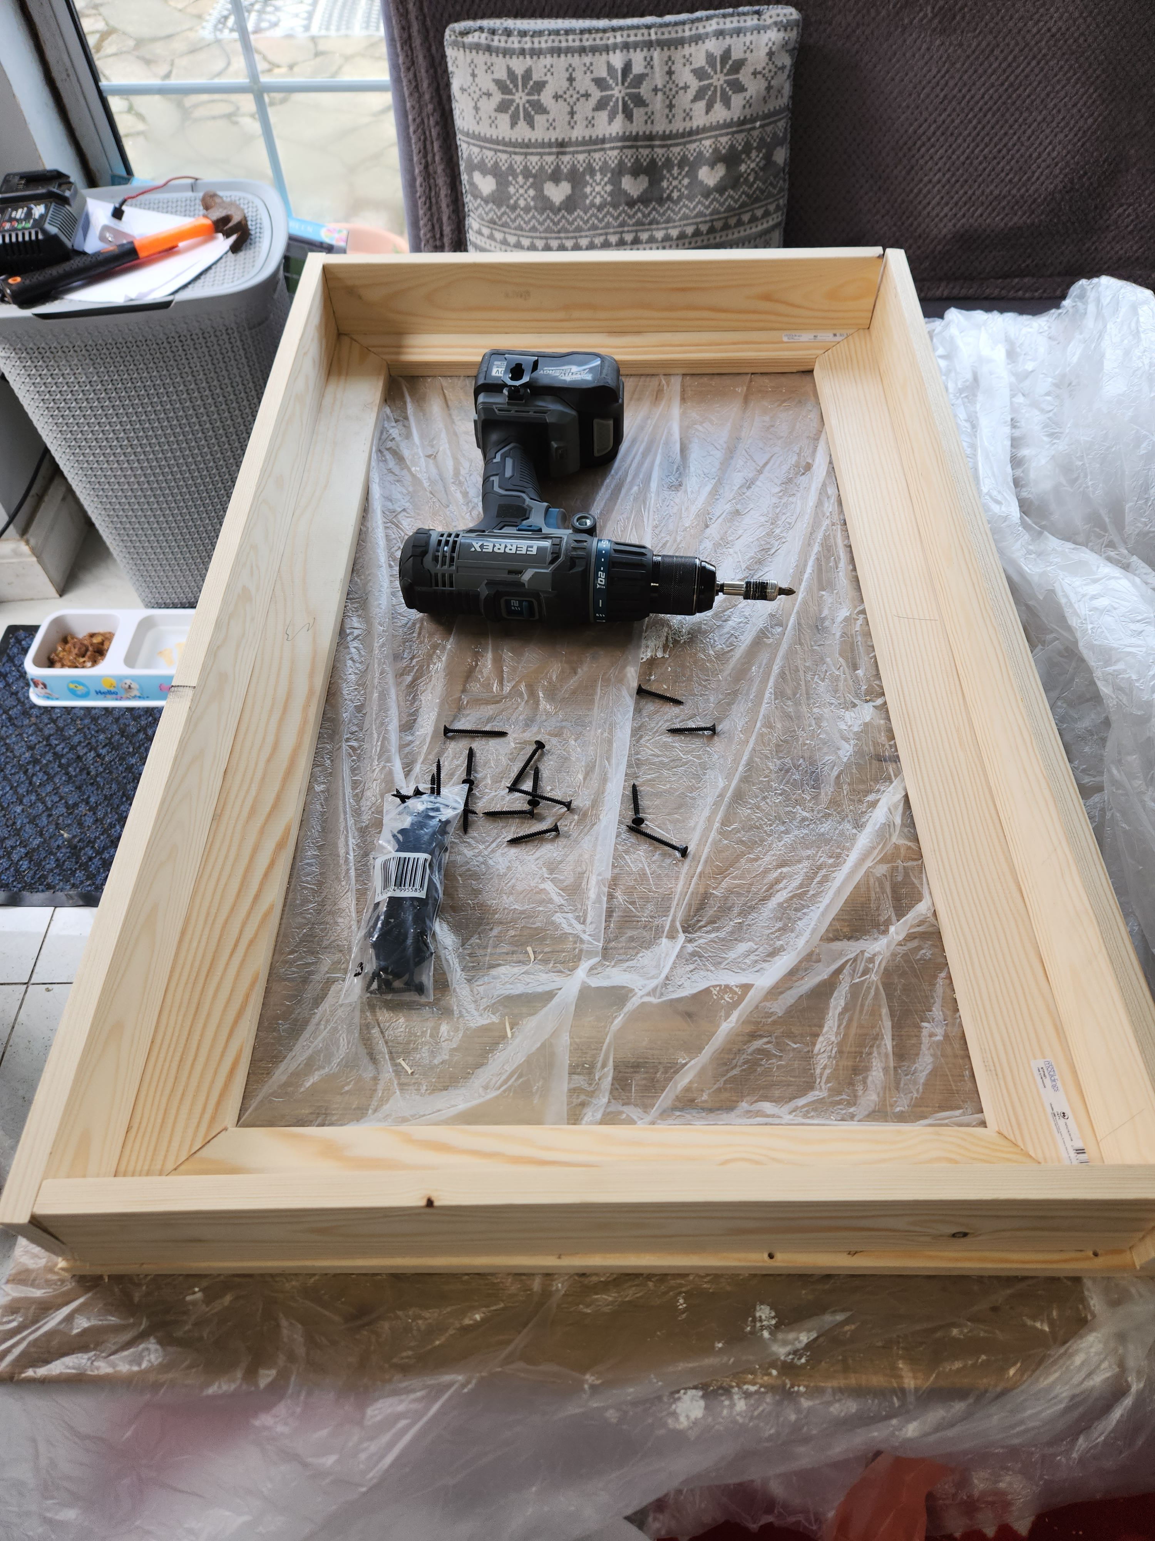

SMART MIRROR
Physical component made – Smart Emotional Recognition Mirror:
15mm x 40mm planks of wood
3.5mm screws at various lengths
Hand Saw
Jigsaw Saw
Single Bevel Sliding Saw
3mm thick acrylic 2-way mirror
AOC 31.5” monitor
Infrared Frame
Raspberry PI

Slide 11

REFLECTION
Overall a success.
However would have loved to be able to develop more.

Slide 12
THANK YOU!
Conor Weldon
Phone:
085-289-8382
Student Number:
N00191746
Email:
N00191746@iadt.ie

